Slide 1



PC Organizer on aXes!!!
Fairdinkum

Slide 2
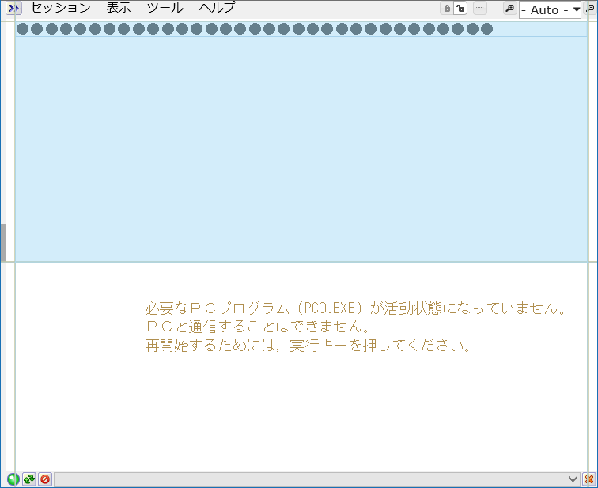
PC Organizer Screen(aXes)
Signature:
A.QDORDSPF.PCOEXTRM
When STRPCCMD command executed, screen shown right appears.
Change type attribute of <input> Tag from “password” to “text” using IE11 F12 Developer Tool, then the value can be recognized.

Slide 3
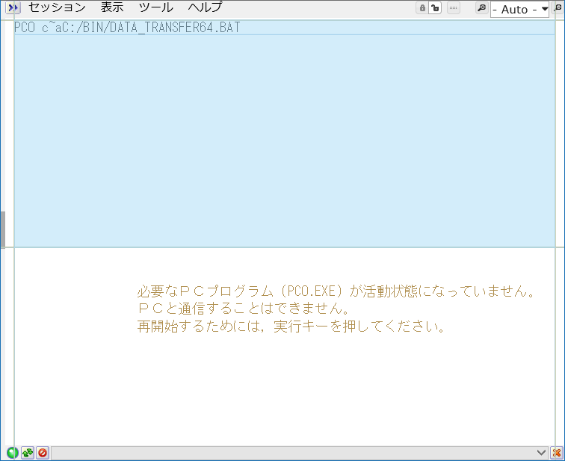
PC Organizer Screen(aXes)
This field contains PCCMD parameter of STRPCCMD command.
Passing this string to PC side program and then realize STRPCCMD as Pcomm does.

Slide 4
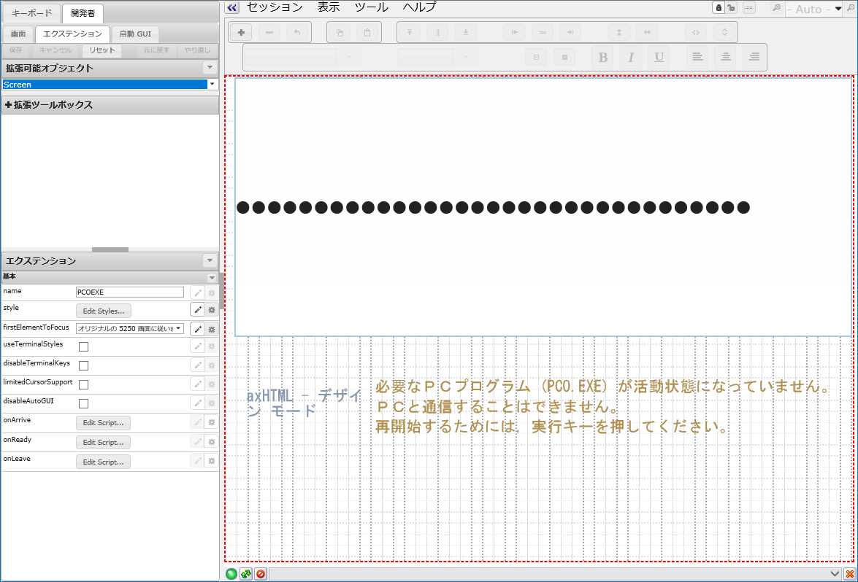
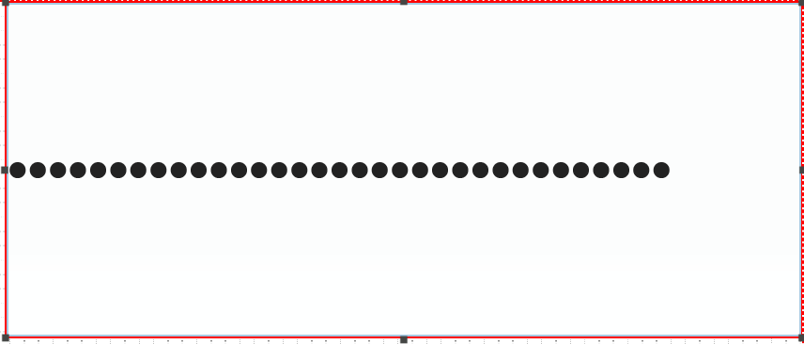
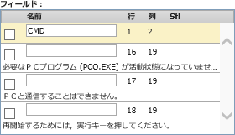
Name the field
Name “CMD” to the 1st row 2nd column input field.

Slide 5
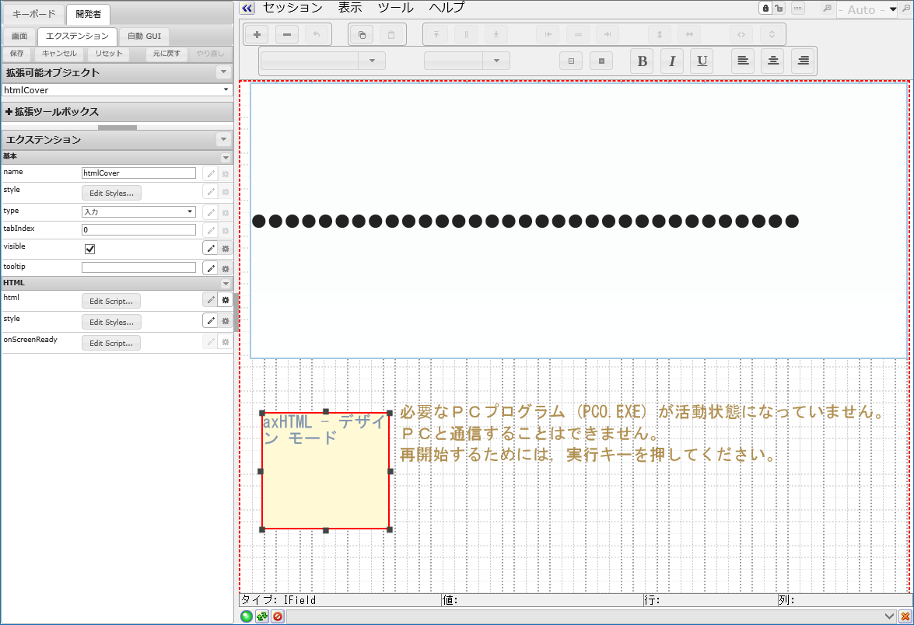
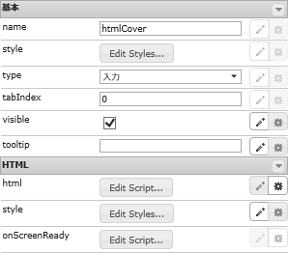
HTML
(Animation GIF)
var html = "";
html += "<table style=\"width:100%;height:100%;background:#ffffff;\">";
html += "<tr>";
html += "<td style=\"font-family:Meiryo UI;font-weight:bold;font-size:24px;color:#808080;vertical-align:middle;text-align:center;\">";
html += "処理中です...<br>";
html += "<img src=\"/ts/ts2/css/images/spinner.gif\">";
html += "<div id='htmlCoverMessage' style='font-size:12px;'>&nbsp;</div>";
html += "</td></tr></table>";
ENV.returnValue = html;
Add Raw HTML and name it htmlCover .
Copy the sample script shonw top right to the html propaty (it should be changed to script mode in advance)

Slide 6
Screen Level
Customization
var cmd1 = FIELDS("CMD").getValue().replace(/\xA5/g,"\\");
var index1 = cmd1.indexOf(":");
var index2 = cmd1.indexOf("\\\\");
if ( index1 >= 0 ){
var c = cmd1.substr(index1-1);
} else if ( index2 >= 0 ) {
var c = cmd1.substr(index2);
} else {
var c = "";
}
USERENV.pcCmd = c.replace(/\xA5/g,"\\");
/*
* PCコマンド文字列の有無をチェック
*/
if ( USERENV.pcCmd !== "" ){
// ユーザーモードのときは画面を戻すためにEnterを自動送出
if ( !AXES.isDeveloper() ){
SENDKEY("Enter");
}
// AXESコマンドハンドラー
window.open("axescmd://usercmd/" + USERENV.pcCmd , "_blank");
USERENV.pcCmd = "";
}else{
//コマンド文字列が無いときはEnterを返して終了
SENDKEY("Enter");
}
Copy&paste the sample script to onArrive and onReady.
onArrive:
Retrieves command string from the URL parameter and passes it to the Power Shell script.
onReady:
Covers the original 5250 screen with the HTML (contains animation gif) contents.
FIELDS("htmlCover").setProperty(
"style", {"height":"410px",
"left" :"2px",
"top" :"2px",
"width" :"570px"
}
);
FIELDS("htmlCover").refresh();

Slide 7
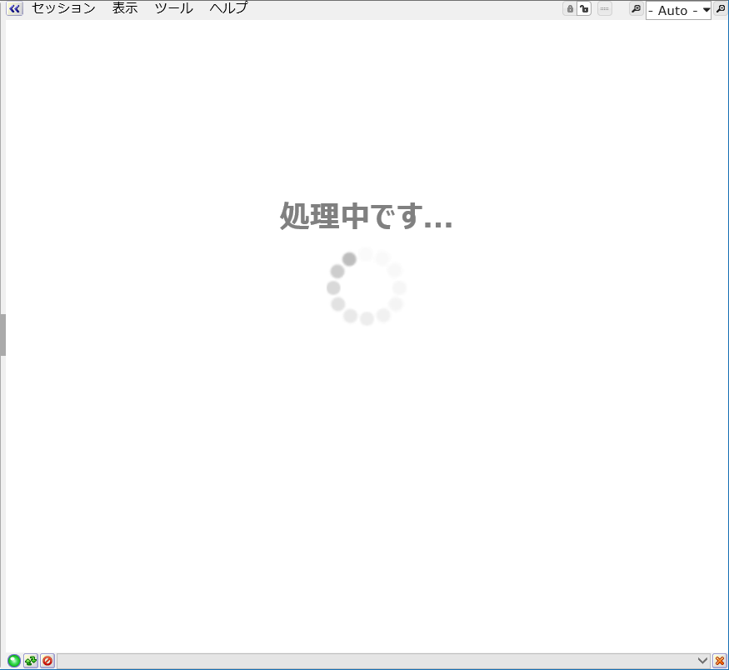
After the customization…
The screen becomes like this.

Slide 8
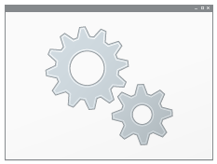
PC side settings
Execute setting.bat and then the settings will complete.
URL scheme “axescmd” becomes available and it allows the internet browsers to pass URL parameters to the PC side Power Shell script.
(Refer the following pages for more information.)
NOTE: We are testing on Windows 10 PCs.

Slide 9

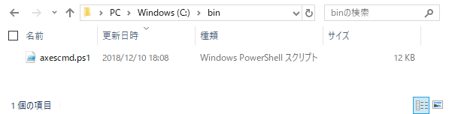
PC Side Settings
Power Shell script
axescmd.ps1 will be put into C:\bin\ folder.

Slide 10

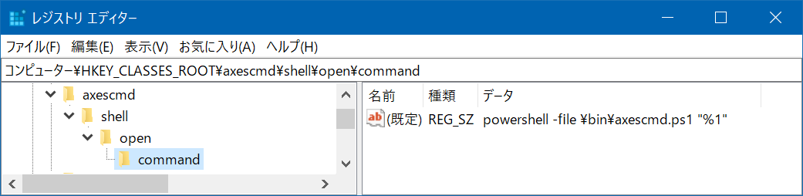
PC Side Settings
Add Registry
Add a registry key so that URL scheme “axescmd” available.

